Slide 1

Bank Loan Analysis Report

Slide 2

Group 6
Team Members
Chandra Moruboina
Sanskruti Suryakant Admane
Renugha Devi Santhakumar
Chandula Jhanshy padma
Danish Ilyas Khan
Deepak Pandey
Vibhav Vohra

Slide 3
Dataset’s Used
Datasets: Finance_1.xlsx & Finance_2.xlsx
Dataset Type: Excel Data
Dataset Size: Each Excel file has 39k+ records

Slide 4
Agenda
Introduction
Key Parameter Indicators(KPI’S)
Charts with Insights
Dashboard’s
Timeline
Conclusion

Slide 5
Introduction
U.S. Bank offers secured loans designed for customers, which can be used for various purposes such as consolidating debt or funding a major purchase. You can apply online, and they provide tools like a personal loan calculator to estimate monthly payments. Remember to check the eligibility requirements and terms carefully.
They provide a range of banking services, such as checking accounts, credit cards, home loans, and online banking. The main types of facilities are overdraft services, business lines of credit, term loans, and letters of credit.

Slide 6
(KPI’s) Key Parameter Index
Year wise loan amount Status
Grade and sub grade wise revolving balance
Total Payment for Verified Status Vs Total Payment for Non Verified Status
State wise and month wise loan status
Home ownership Vs last payment date status

Slide 7
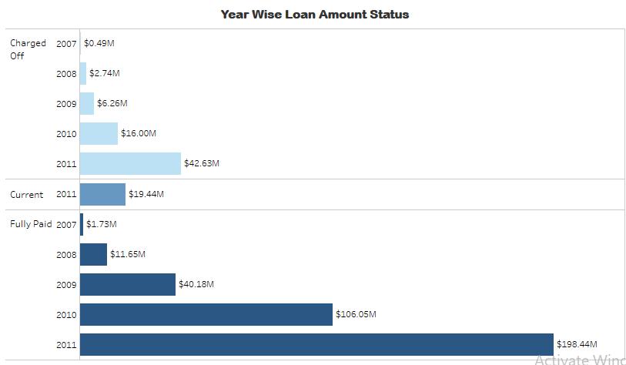
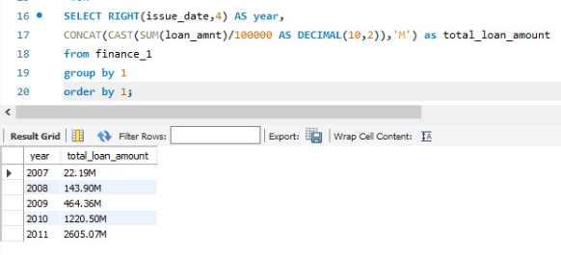
Charts with Insights
Year wise loan amount Status
Examining the year-wise loan status provides insights into the historical performance of loans, identifying trends and patterns. The project analyzed loan amounts over different years. It's essential to monitor trends in loan applications and disbursements to understand the bank's lending strategy and overall health of the loan portfolio.

Slide 8
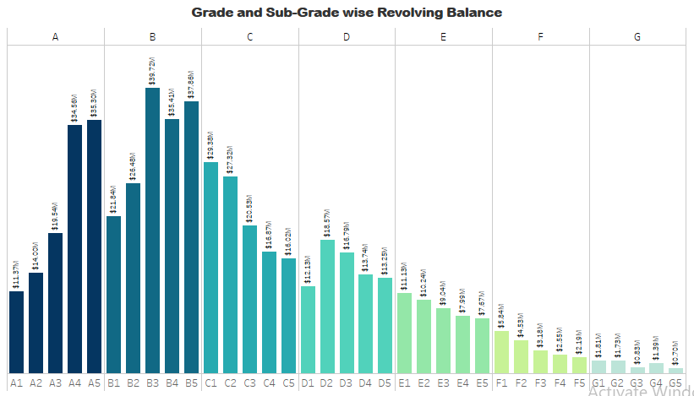
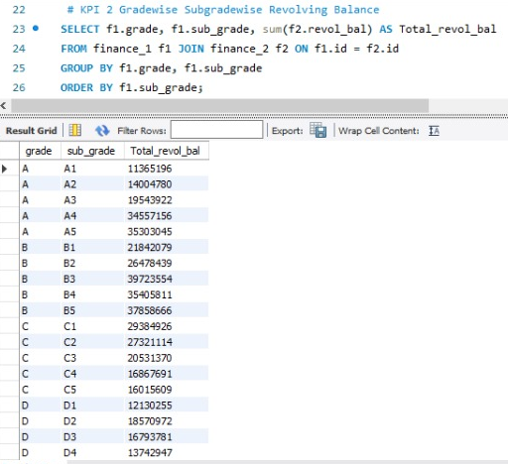
Grade and Sub Grade wise Revolving Balance
Understanding revolving balances across different loan grades and sub-grades offers a nuanced view of risk distribution. Focusing on creditworthiness (grades and subgrades), the project likely assessed the revolving balances associated with different loan categories. This information aids in risk assessment and portfolio management.

Slide 9
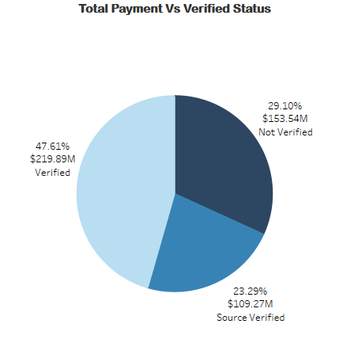
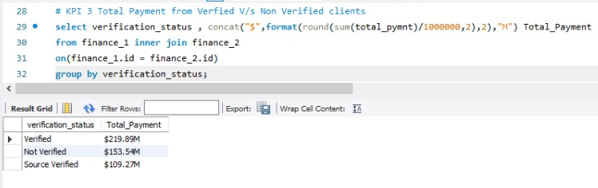
Total Payment for Verified Status Vs Total Payment for Non Verified Status
Understanding payment patterns based on verification status provides insights into the reliability of borrower information. By comparing payments for verified and non-verified loans, the project likely identified patterns related to borrower credibility. Verified loans may have higher payment compliance, while non-verified loans could exhibit varying payment behavior.

Slide 10
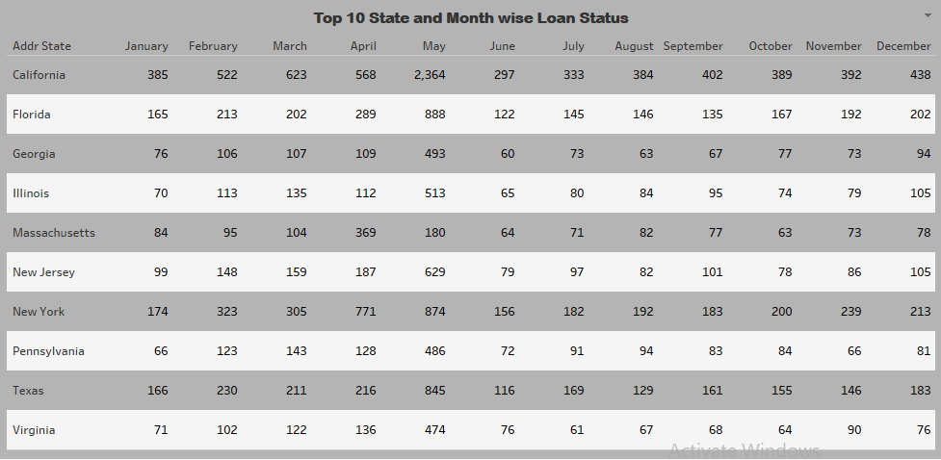
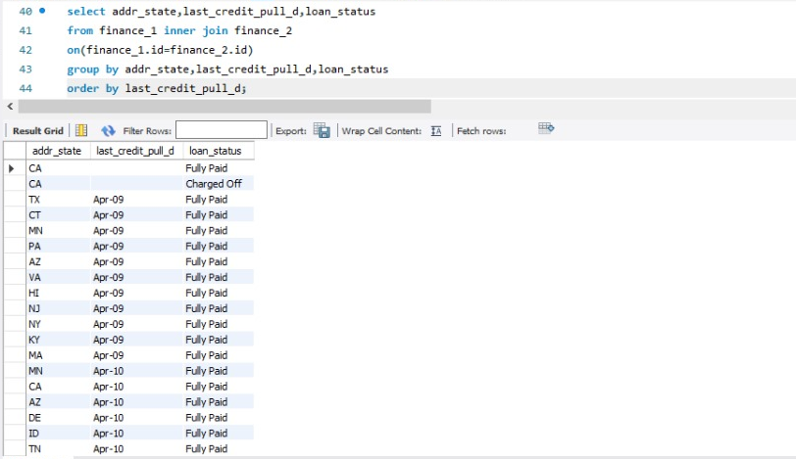
State wise and month wise loan status
The project explored loan status variations across different states and months. This analysis helps identify regions with higher loan demand, seasonal patterns, and potential risk areas. By categorizing loans based on states, the dashboard allows for a regional analysis of loan statuses such as fully paid, charged off, and current. Providing counts of loan statuses by state reveals the distribution of loan performance across different regions.

Slide 11
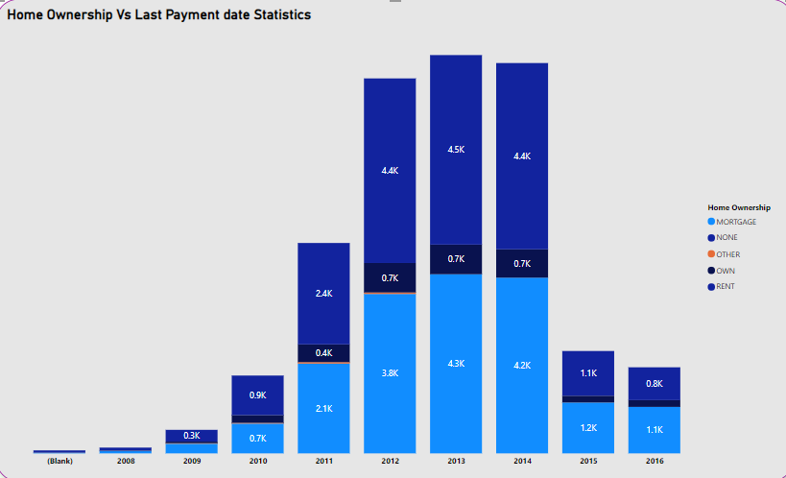
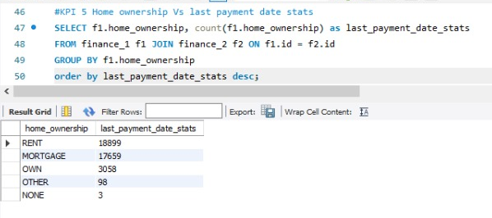
Home ownership Vs last payment date status
Bank might have investigated how home ownership status correlates with payment behavior. Understanding whether homeowners tend to make timely payments provides insights into loan performance.

Slide 12
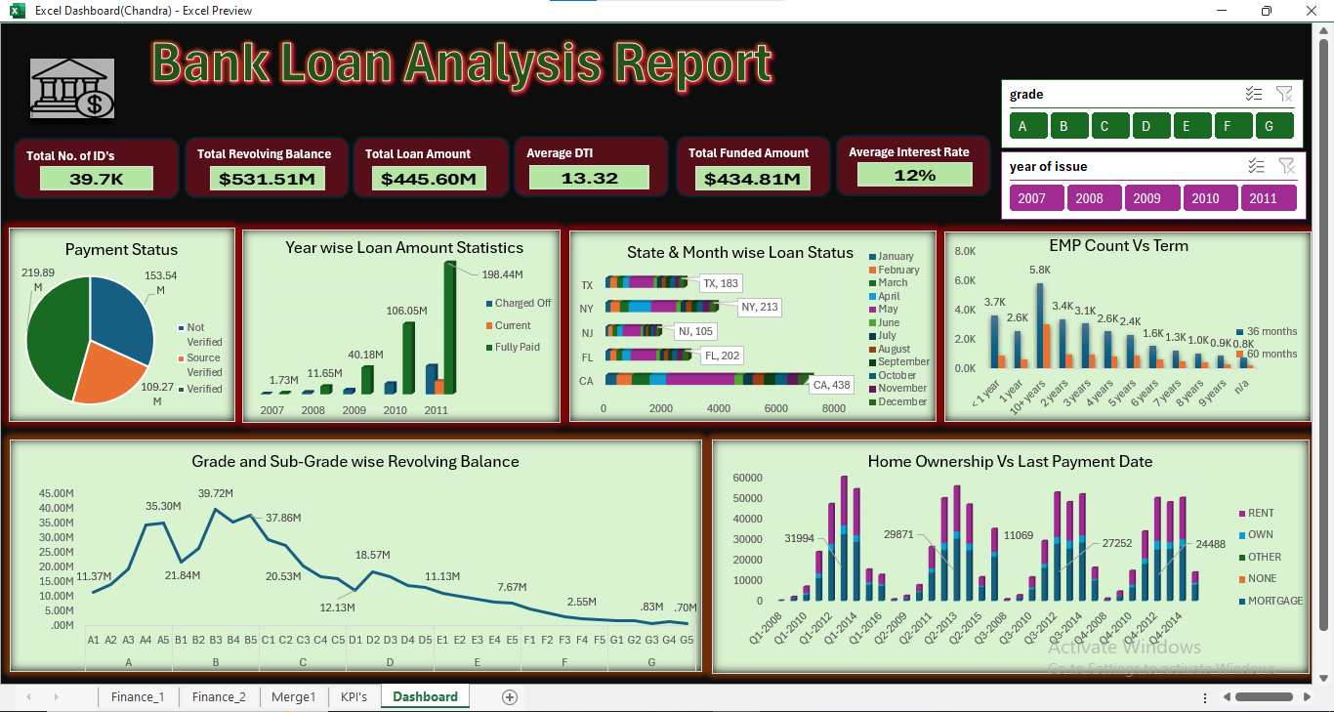
Excel Dashboard

Slide 13
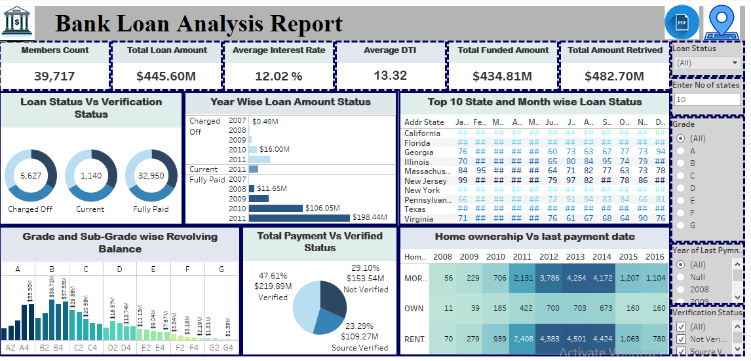
Tableau Dashboard

Slide 14
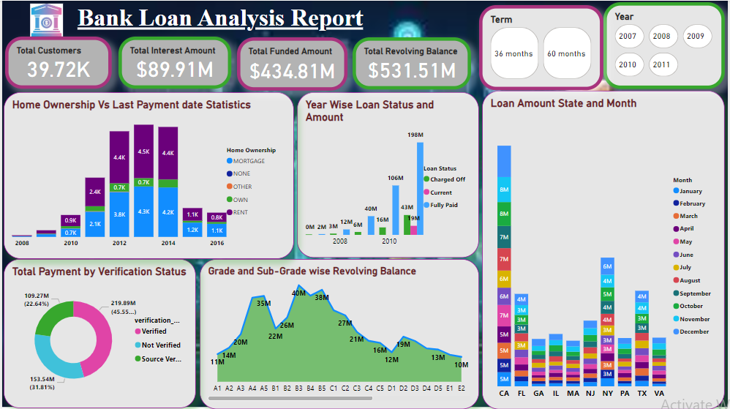
Power BI Dashboard

Slide 15
Timeline
21 Nov 2024
28 Nov 2024
05 Dec 2024
12 Dec 2024
19 Dec 2024
Project Kick-off Start
Implementation of KPI’s using Excel
Implementation of KPI’s using Tableau
Implementation of KPI’s using Power BI
Final Presentation of the Project & SQL

Slide 16
Conclusion
This bank analytics project aims to provide insights into the overall performance of the bank. By analyzing various aspects of the sales data, we seek to identify trend , make data-driven recommendations and gain a deeper understanding of the bank's performance.
In this analysis two data sets were used which contained detailed information about the bank. Finance_1 and Finance_2 were the names of the data sets used.
In order to monitor and assess our bank's lending activities and performance, created a comprehensive Bank Loan Analysis Report. The goal of this Excel project is to comprehensively analyze bank loan data by tracking key performance indicators (KPIs). Bank loans are a crucial financial tool that enables individuals and businesses to achieve their goals and mange financial needs.
The objective was to provide insights into key loan-related metrics and their changes over time, aiding data-driven decision-making, tracking loan portfolio health, and identifying trends for lending strategy.

Slide 17

Thank you

